Slide 1
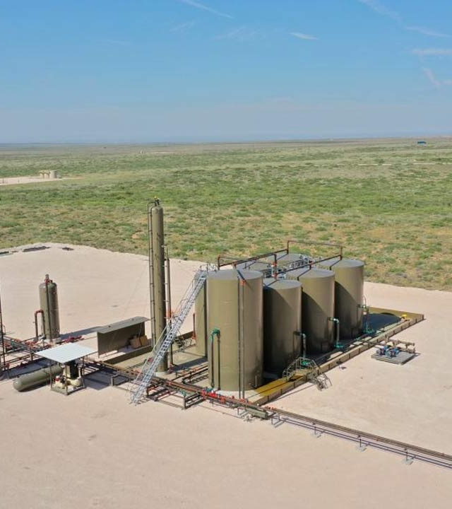
Two Birds, One Stonebridge
Stonebridge Group 2
December 7, 2025
Our findings on the impact of saltwater injection wells on nearby production wells

Slide 2
Agenda
Two Birds One Stonebridge
1
2
3
Background & Context
Overview & Goals
Methods
4
5
6
Findings
Recommendations
Limitations & Next Steps

Slide 3
BACKGROUND & CONTEXT
Two Birds One Stonebridge

Slide 4
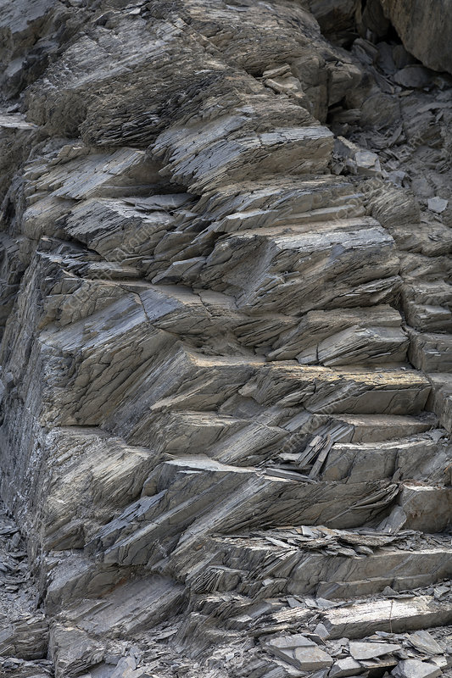
Horizontal hydraulic fracturing reshaped U.S. oil & gas production
Ohio’s shale formations enabled rapid growth
Rising wastewater volumes created new management challenges
Two Birds One Stonebridge
Background
Notes:
Over the past twenty years, hydraulic fracturing has dramatically expanded oil and gas production across the U.S., especially in states like Ohio where shale formations are rich in hydrocarbons. This growth has been accompanied by a sharp increase in wastewater generated from fracking, creating new operational and environmental challenges. Our work focuses on understanding how this wastewater is handled and what it means for production activity.

Slide 5
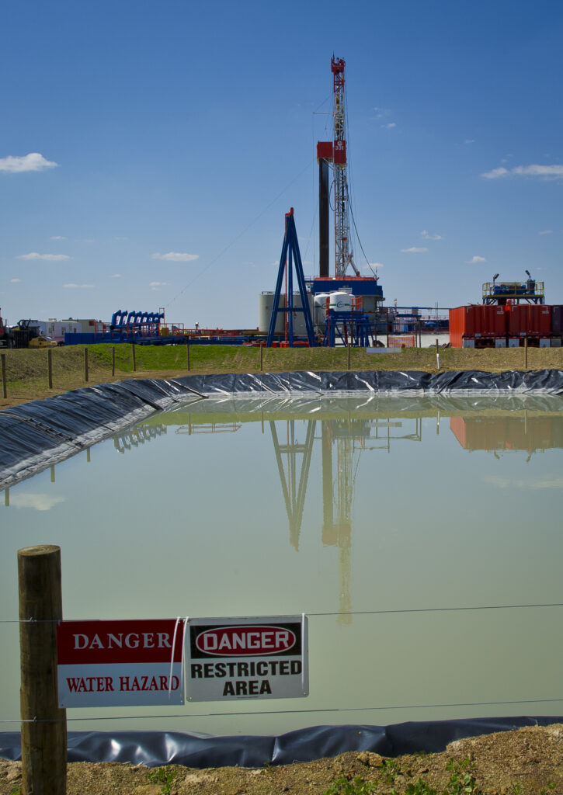
Fracturing shale releases oil, gas, and large volumes of wastewater
Wastewater contains brine, additives, and deep subsurface materials
Safe disposal is essential for resource and environmental protection
Two Birds One Stonebridge
Fracking & Wastewater
Notes:
When shale is fractured, significant amounts of fluid return to the surface. This wastewater contains highly saline brine, chemical additives, and materials pulled from deep underground. Because of its composition, disposing of it safely is essential—not only to protect drinking water, but also to maintain the stability of the reservoir after production.

Slide 6
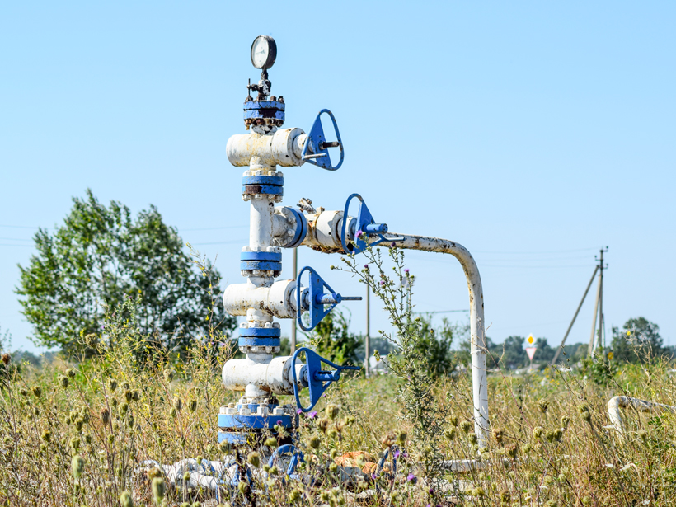
Deep injection wells isolate wastewater from sensitive formations
However, underground pressure can shift
Pressure changes may influence nearby production wells
Two Birds One Stonebridge
Injection Wells & Why They Matter
Notes:
The primary disposal method is deep underground injection, which keeps the wastewater away from sensitive formations. But injection also changes subsurface pressure. Those pressure changes can extend outward from an injection well and potentially influence nearby production wells. This may reduce output efficiency or cause fluids to migrate in unintended ways.

Slide 7
Investigate how injection activity relates to production changes
Examine distance-based effects
Evaluate variations across well types and geologic settings
Two Birds One Stonebridge
Project Objectives
Notes:
This project examines the relationship between injection well activity and nearby oil and gas production. We look at whether production changes are associated with injection volumes, how these effects vary with distance from the injection well, and how geology and well type may influence the strength of these interactions.

Slide 8

Supports safer long-term resource development
Helps maintain reservoir integrity
Promotes sustainable oil & gas operations in Ohio
Two Birds One Stonebridge
Impact and Importance
Notes:
Overall, this work supports safer, more sustainable development of Ohio’s oil and gas resources. By better understanding the relationship between injection and production wells, Stonebridge can protect reservoir integrity, minimize environmental impacts, and plan more effectively for the future.

Slide 9
OVERVIEW & GOALS
Two Birds One Stonebridge

Slide 10
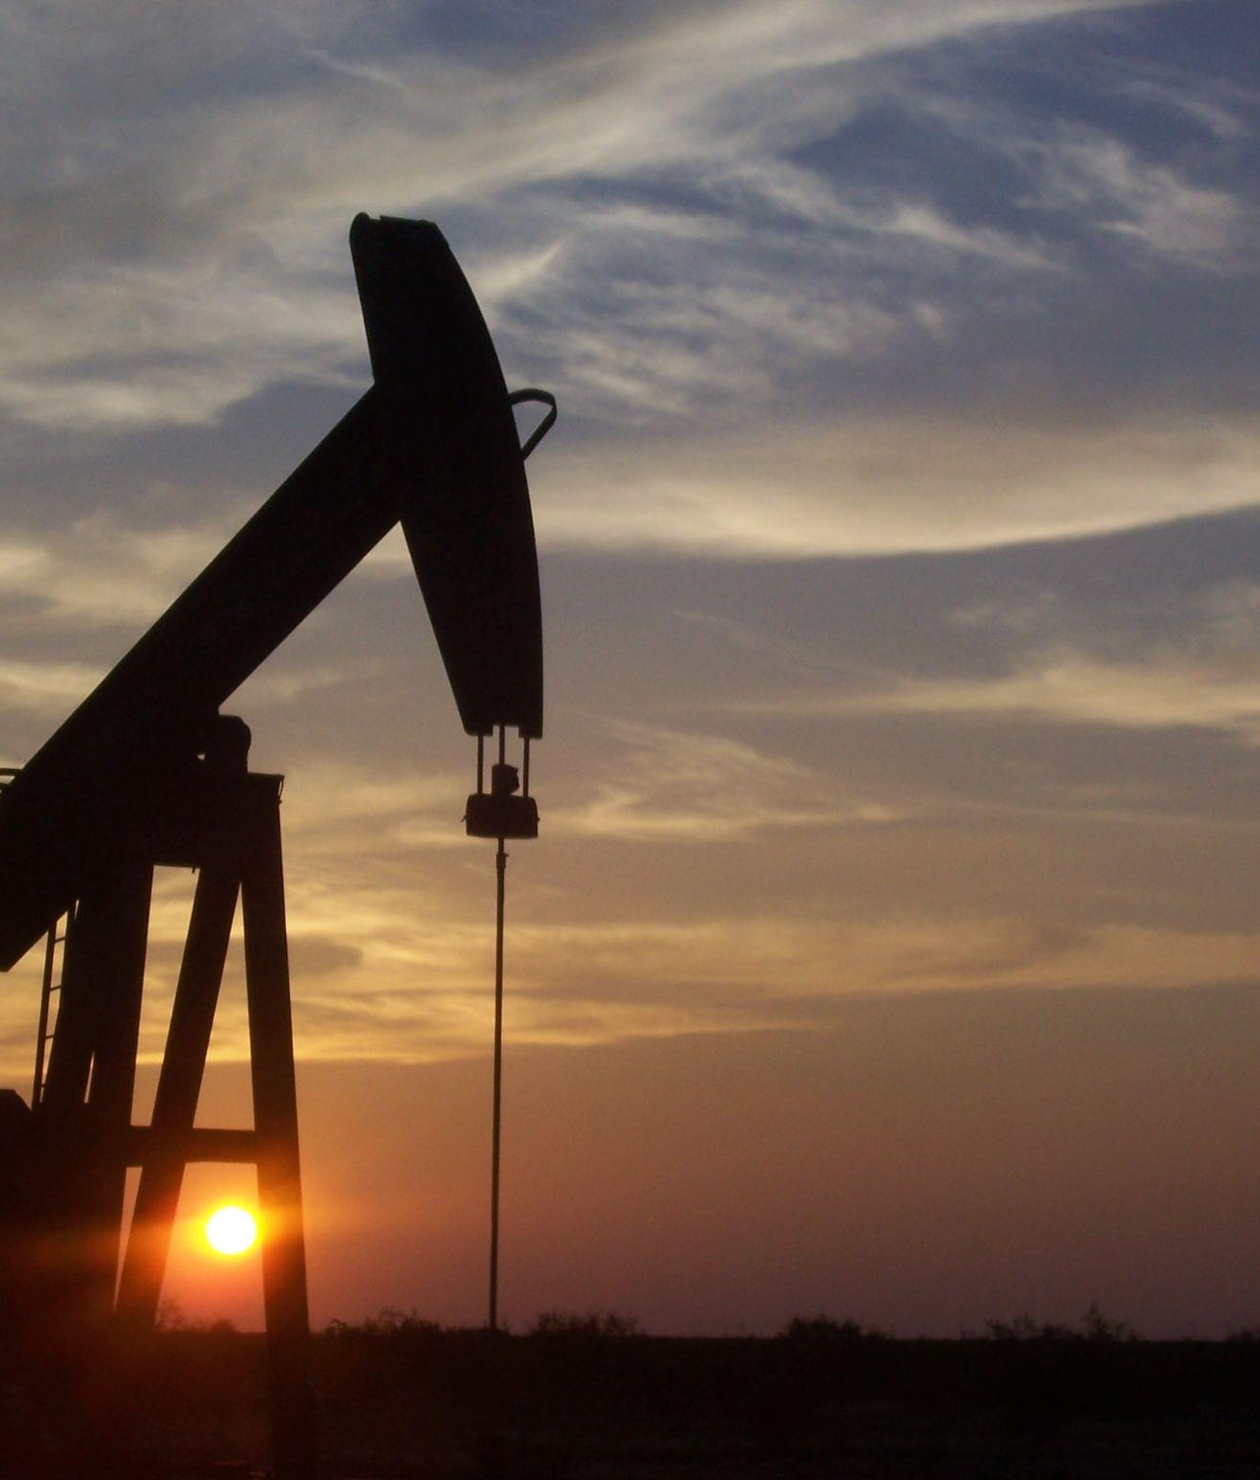
We used a Difference-in-Differences modeling structure to evaluate the effect of Saltwater Injection Wells (SWIW) on nearby Production Wells.
In doing so, we did not find evidence to suggest that SWIW have a direct impact on oil and gas production.
Two Birds One Stonebridge

Slide 11
DATA & METHODS
Two Birds One Stonebridge

Slide 12
Our project relied heavily on data accessed from the Ohio Department of Natural Resources.
Two Birds One Stonebridge
Production Reports
ODNR Well Database
01
02
03
Well Production Data
Permit and Plug List
Well Information
Quarterly production reports for horizontal wells, annual production reports for vertical wells since 2010.
Permit date, well classification, and location for every well drilled in OH since 1998.
More details on well locations and owners for all active wells.

Slide 13
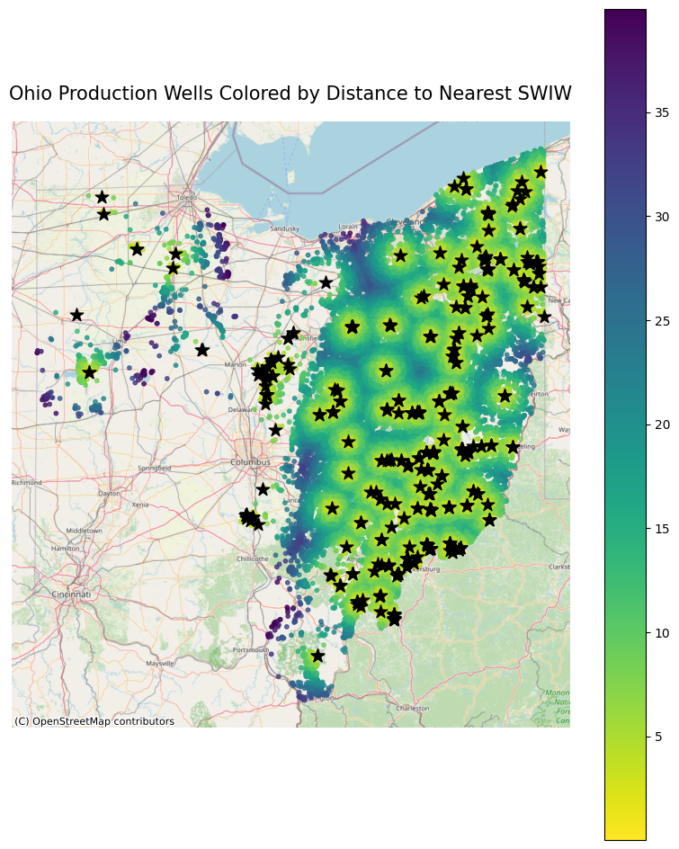
We built Difference-in-Differences models to compare well production before and after a given date.
Two Birds One Stonebridge
Data Used
Annual production of all wells within 3km of nearest SWIW, using well location data to calculate inter-well distances.
Model Structure
Split data by whether it is before or after a given date. Use the interaction between that and the distance of each well to the nearest SWIW to predict production.
Models Built
One gas model and one oil model for three split dates: the date the nearest SWIW was permitted, one year after that, and two years after that.

Slide 14
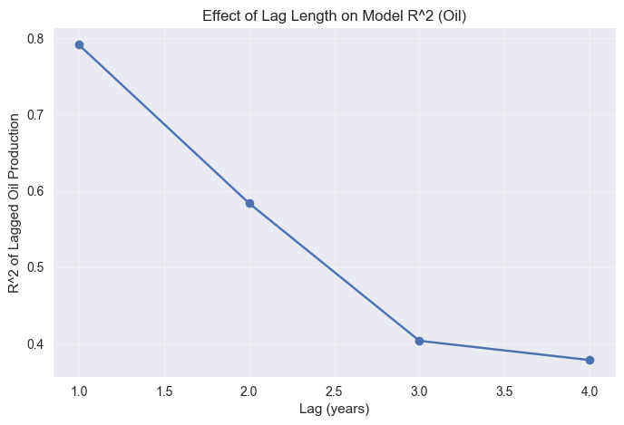
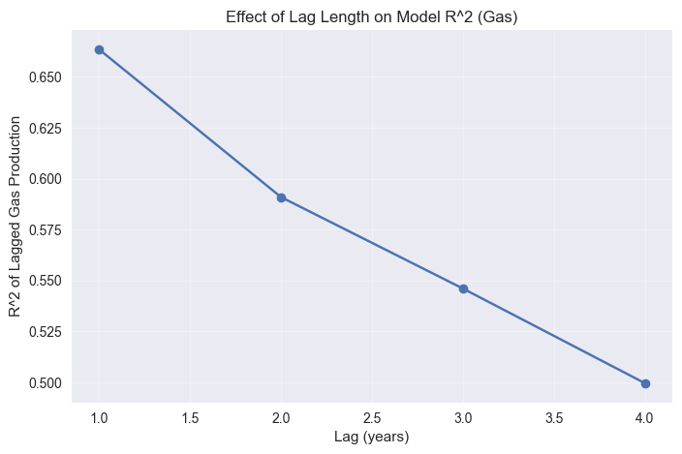
Why split on those dates?
Two Birds One Stonebridge
We used a Lag Analysis to investigate how correlated the year-to-year production data is.

Slide 15
FINDINGS
Two Birds One Stonebridge

Slide 16
After building 6 Difference-in-Differences models to evaluate the impact of SWIWs on well production, we came to these conclusions.
Two Birds One Stonebridge
No Model Had A Significant DiD Coefficient
We cannot conclude that SWIW have any impact on the production levels of oil and gas producing wells for those within 3km and with pre-SWIW and post-SWIW production.
The Oil Model With No Lag Was Significant
However, the significance was only related to the distance effect. This indicates that SWIW may intentionally be drilled where oil production is lower.
Individual Well Differences Are Notable
We created plots to display the differences between individual well production before and after the split date. Most have small differences, but outliers are notable.

Slide 17
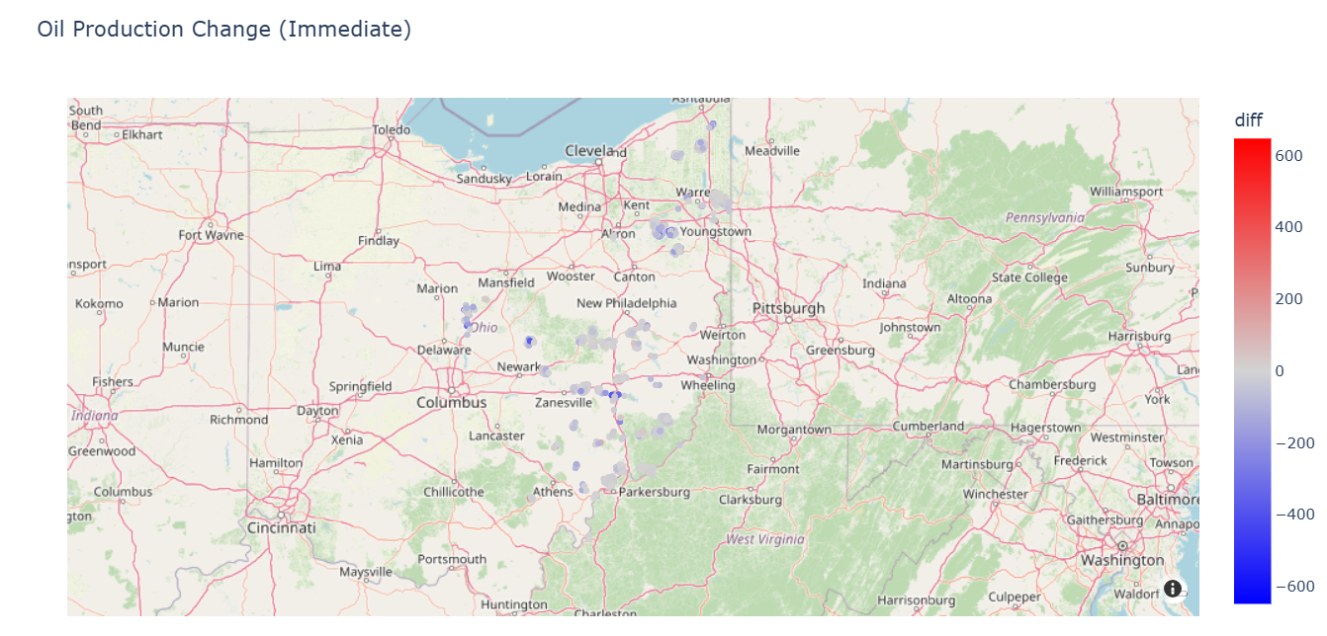
Two Birds One Stonebridge

Slide 18
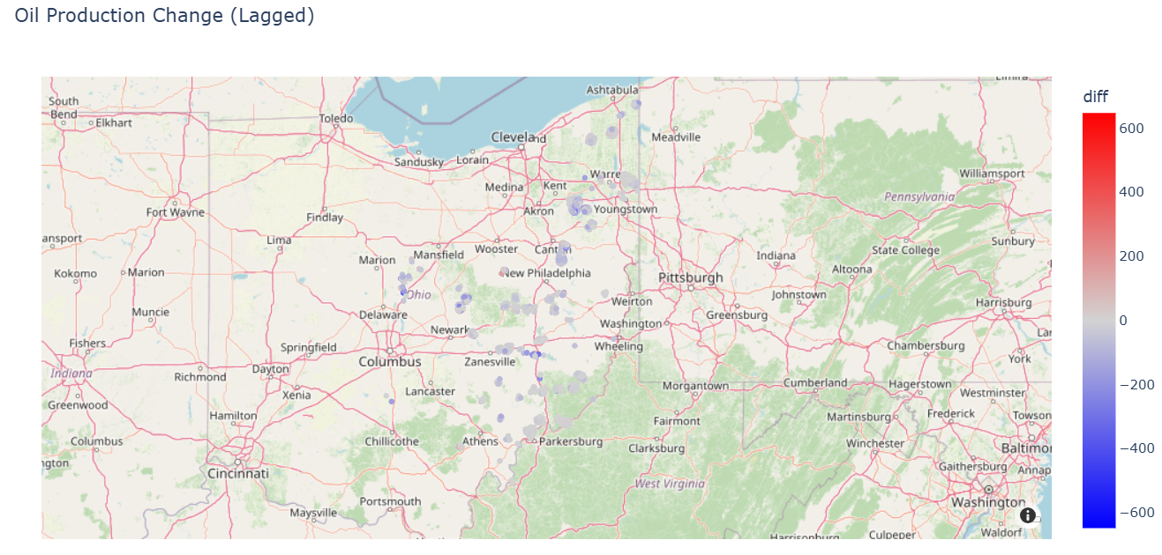
Two Birds One Stonebridge

Slide 19
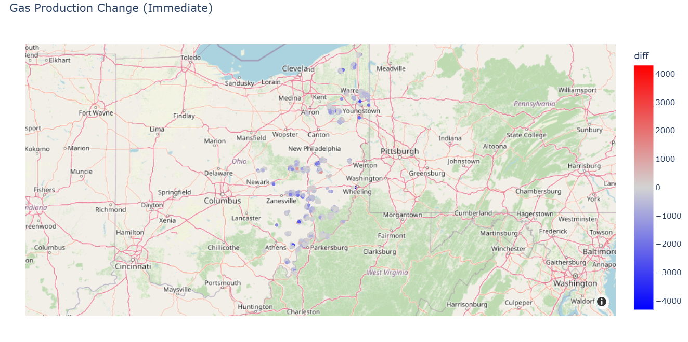
Two Birds One Stonebridge

Slide 20
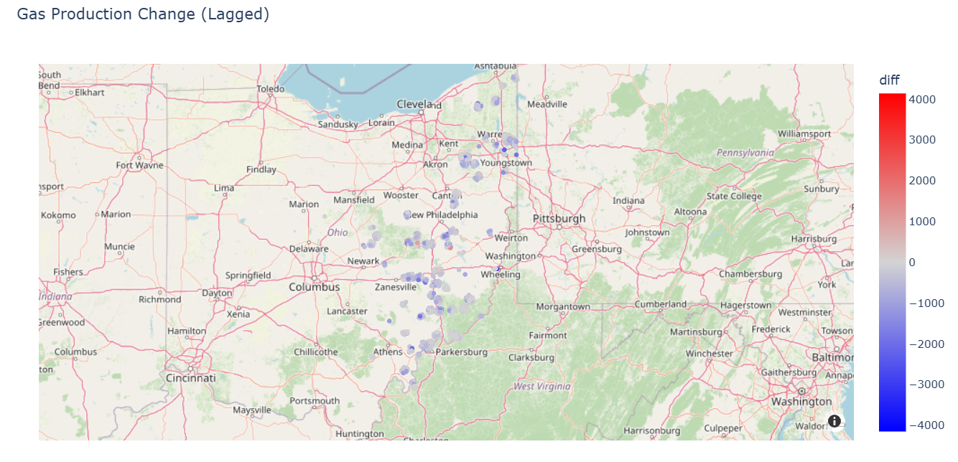
Two Birds One Stonebridge

Slide 21
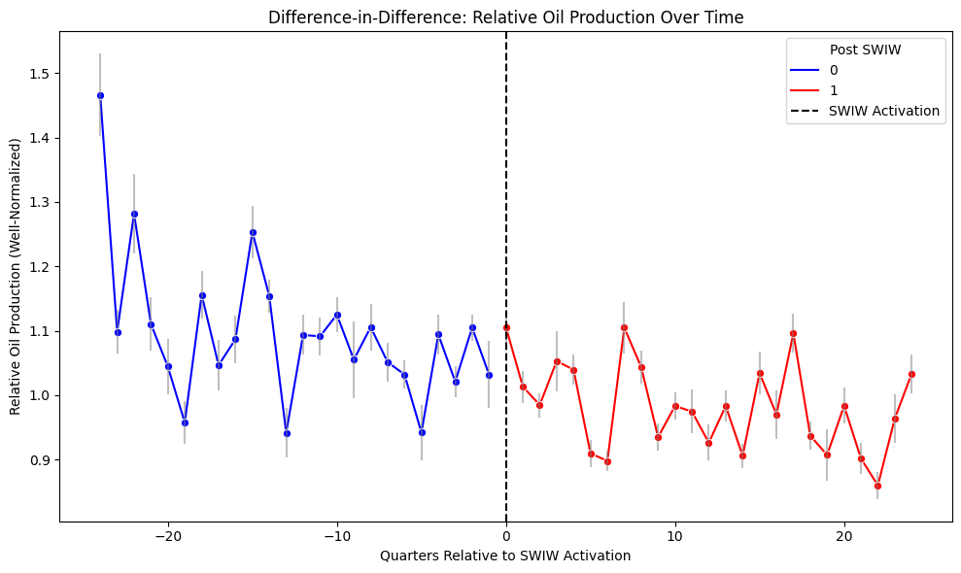
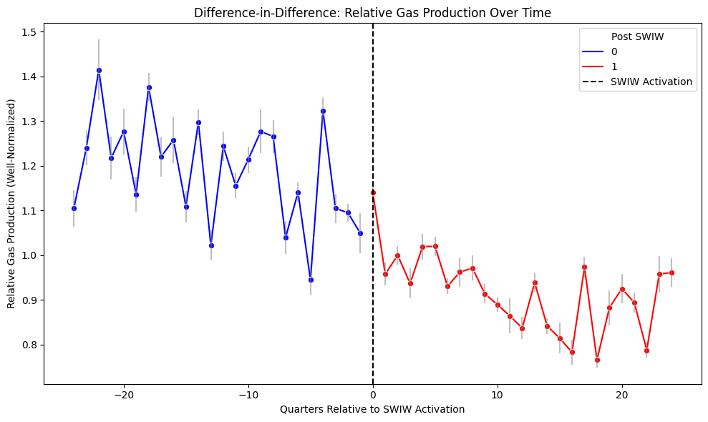
We see a clear downward trend in oil production, but it largely happens before the SWIW is permitted.
For gas, the drop off occurs after the SWIW is permitted.
Two Birds One Stonebridge

Slide 22
RECOMMENDATIONS
Two Birds One Stonebridge

Slide 23
Two Birds One Stonebridge
Recommendation 1
Recommendation 2
We recommend against using this research as evidence that SWIW have no effect on nearby production wells.
Although our model did not have sufficient evidence to conclude that there is an impact, the downward trend in production and the outlier wells identified in our visualization show that our model may not be fully robust.
We recommend further investigation into the specific wells that showed a decrease in production after the split dates.
We believe that these wells may have been impacted in some way by the drilling of nearby SWIW.

Slide 24
LIMITATIONS & NEXT STEPS
Two Birds One Stonebridge

Slide 25
Our project's greatest limitation was a lack of data access.
Two Birds One Stonebridge
01
02
03
STATE-TO-STATE SWIW COMPARISON
ORIGIN OF BRINE INJECTED IN OH
INCOMPLETE PA/WV PRODUCTION DATA
Lacked dataset containing flag for well type for PA and WV, so we could not explore how injection patterns vary by state..
No response from ODNR for our request to access Form 13 Brine Hauling Logs.
Oil and gas production data from PA/WV wells was available, but not for the full set of years we were looking to analyze.

Slide 26
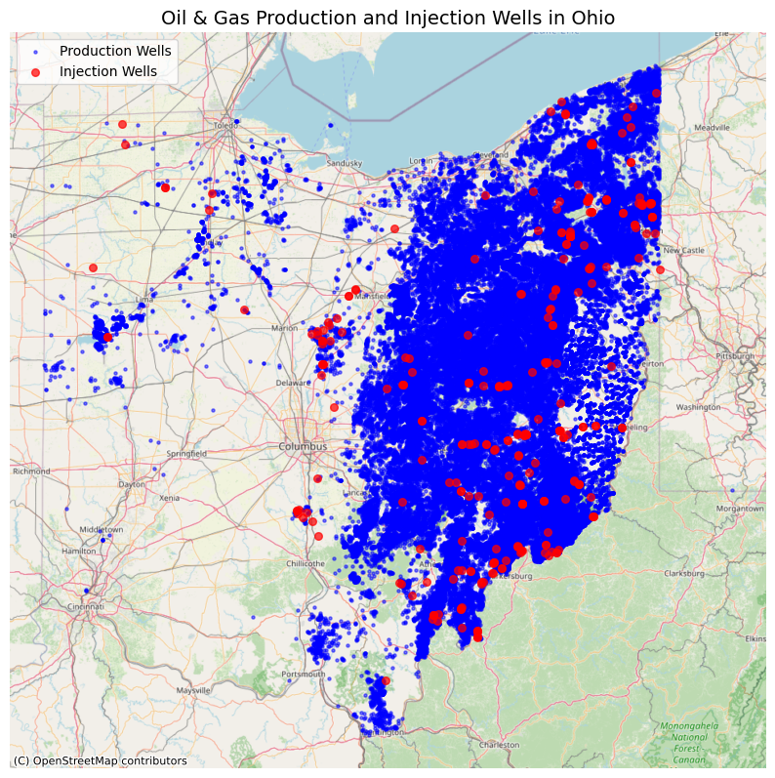
Our project was also limited by computational complexity.
Two Birds One Stonebridge
With over 73,000 production wells in the full dataset, creating a fixed effect for each model was too computationally intensive.
Thus, we limited to only consider wells within 3km of the nearest SWIW.

Slide 27
We believe these three steps can expand our research to provide more robust results.
Two Birds One Stonebridge
Improve Model Structure, Model Full Dataset
With a non-DiD structure, we may be able to use the full set of data to see how production changes for all wells, not just those inside of 3km.
Obtain Brine Logs and Investigate Origins
Future research should again attempt to obtain brine hauling logs and explore where the injected brine comes from and how much is injected in OH vs neighboring states.
Examine Wells That Cease Production
Our analysis only considers wells with production both before and after the split date. This fails to account for wells who cease production entirely due to SWIW impact.

